Slide 1
COACHING FOR SOCIAL IMPACT
Notes:
This module is used to create a space for discussion and sharing on the possibilities for societal impact through coaching. We are pleased to share this coaching approach for use in promoting Societal Progress.
Use of this material is suggested after students have become developed and have completed their learning journey.
This session can last anywhere between 30 min to an hour, depending on the time allotted for the global common questions.
This session will assist in acknowledging the potential of coaching to impact societal progression. This presentation has qualified for CCE's in previous conferences and sessions

Slide 2
As coaches, we know that the right questions at the right time in the right place can change conversations and make an impact.
The ICF Foundation works to:
Equipping coaches, chapters, family organizations
Amplification through coaching against frameworks
Determining and finding the Insertion points
Invitations supported by equipping/frameworks
Notes:
Recommendations for positioning this slide:
As the Foundation works with the coaching community, we will work to equip and connect. We look for the insertion or intervention point within an organization's framework. These frameworks range from NGO’s system/framework (like UNICEF) to small nonprofits structure/framework (a local community nonprofit).
This allows for us to partner with frameworks to showcase the value of coaching.

Slide 3
I exist of, in and for humanity…
I don’t make any sense on my own…
I am because we are…
The planet is my home…
The challenge is vast…
We are not alone…
We are together…
Everything is possible.
Personal learning edge
Notes:
This slide shares the philosophy or spirit of the core values of ICF Foundation.

Slide 4
Global Common Purpose
Given all our resources, working together and in alignment, what is our greatest possible contribution to humanity and the planet?
Notes:
Recommendations for presenting the following 3 engaging and igniting slides:
This experiential facilitation will provide an openness and opportunity for the audience to unite over the next steps for how we realize our potential and responsibility to action.
The following format is suggested for the powerful questions There are no specific tools, techniques and only respectful listening to what we could all be and do together in a collective learning space.
Format:
Ask a question
Taking a minute to individually reflect
Taking 3 mins to share with one or two people around you
7mins to popcorn your thoughts into the main room
3min to develop clarity / seek further questions / gain consensus in the room

Slide 5
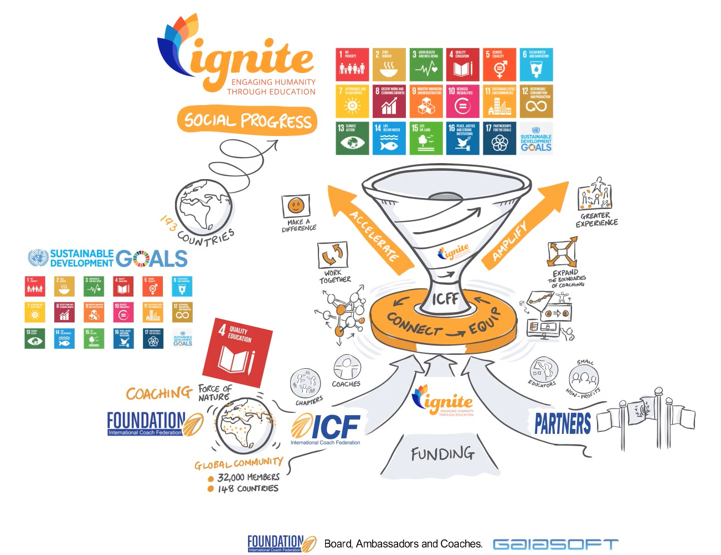
Notes:
ICF Mission and Vision Video

Slide 7
Global Common Purpose
As a coach, when have I experienced the power of coaching to impact humanity?
Notes:
Recommendations for presenting the following 3 engaging and igniting slides:
This experiential facilitation will provide an openness and opportunity for the audience to unite over the next steps for how we realize our potential and responsibility to action.
The following format is suggested for the powerful questions There are no specific tools, techniques and only respectful listening to what we could all be and do together in a collective learning space.
Format:
Ask a question
Taking a minute to individually reflect
Taking 3 mins to share with one or two people around you
7mins to popcorn your thoughts into the main room
3min to develop clarity / seek further questions / gain consensus in the room

Slide 8
Our intent in choosing where to coach
to accelerate progress
to amplify results
to deliver impact that matters
Notes:
ICF Foundation follows these principles to determine where we can ensure the largest impact. We exist to…accelerate progress, amplify results and deliver impact.

Slide 9
Global Common Purpose
What can I do to take coaching skills to areas I can influence?
Notes:
Recommendations for presenting the following 3 engaging and igniting slides:
This experiential facilitation will provide an openness and opportunity for the audience to unite over the next steps for how we realize our potential and responsibility to action.
The following format is suggested for the powerful questions There are no specific tools, techniques and only respectful listening to what we could all be and do together in a collective learning space.
Format:
Ask a question
Taking a minute to individually reflect
Taking 3 mins to share with one or two people around you
7mins to popcorn your thoughts into the main room
3min to develop clarity / seek further questions / gain consensus in the room

Slide 10
How Can You Engage?
Develop a vision, culture and experience of coaching for societal progress in your communities
Share with ICF Foundation your stories of coaching in societal progress
Develop a partnership with ICF Foundation for contribution and Impact at Scale
Notes:
This slide outlines the opportunities of partnering in several areas the include (but are not limited to):
Partnering with the Foundation
Special Olympics Pro Bono Coaching and other Foundation sponsored initiatives
Partnering with Chapters
Joining a chapters ongoing pro bono work with Ignite or partnering with Chapters to begin an Ignite Initiative.
Partnering in existing initiatives
This can include organizations such as Coach Initiative, Catch-a-Fire volunteer portal and many more.

Slide 11
Video: ICF Mission and Vision
Resource Links
Website: www.foundationoficf.org
Connect with the ICF Foundation Staff, information@foundationoficf.org
Notes:
For further details about ICF Foundation- please reference the above links.

